Slide 1
Natural Language Processing Specialization Autocorrect and Minimum Edit Distance
(2021 Deeplearning.ai)
YangXi’s Reading Notes

Slide 2
Autocorrect
For now, we only focus on spelling errors (not contexture errors)
Steps
Identify a misspelled word
Word not in the dictionary
Find strings n edit distance away (n is usually 1 to 3)
Edit: an operation performed on a string to change it
Insert a letter
Delete a letter
Switch 2 adjacent letters
Replace a letter to another
For auto-correct, n is usually 1 to 3
Filter candidates
Calculate word probabilities
To make it simple, let’s use the probability of each word in the corpus

Slide 3
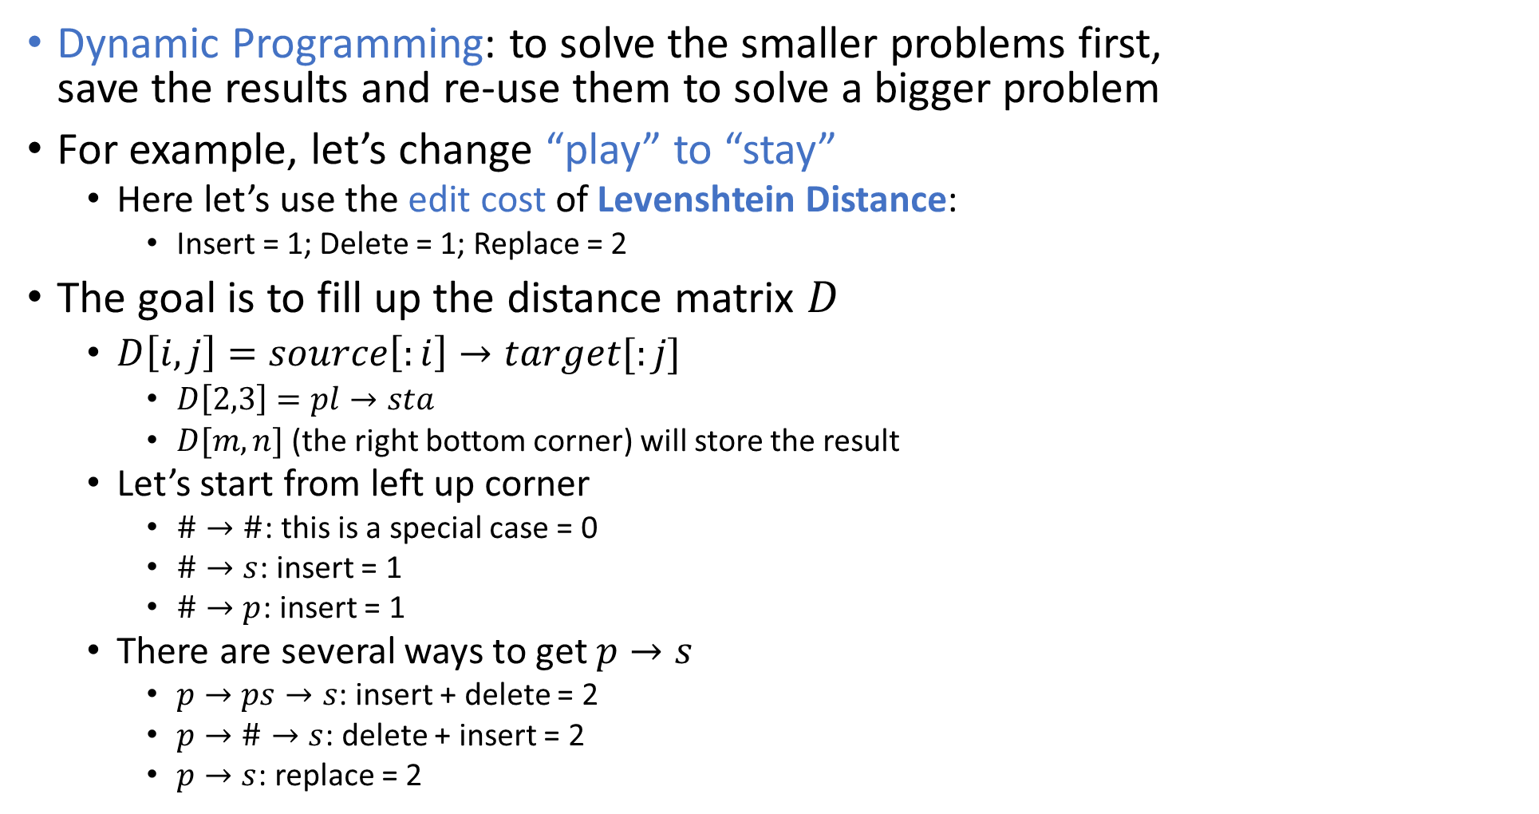
Minimum Edit Distance
0 1 2 3 4
Dynamic Programming: to solve the smaller problems first, save the results and re-use them to solve a bigger problem
For example, let’s change “play” to “stay”
Here let’s use the edit cost of Levenshtein Distance:
Insert = 1; Delete = 1; Replace = 2
The goal is to fill up the distance matrix $D$
$D\left[i,j\right]=source\left[:i\right]→target[:j]$
$D\left[2,3\right]=pl→sta$
$D[m,n]$ (the right bottom corner) will store the result
Let’s start from left up corner
$\#→\#$: this is a special case = 0
$\#→s$: insert = 1
$\#→p$: insert = 1
There are several ways to get $p→s$
$p→ps→s$: insert + delete = 2
$p→\#→s$: delete + insert = 2
$p→s$: replace = 2
 | # | s | t | a | y
#
p
l
a
y
0
1
2
3
4
0 1 2 3 4
 | # | s | t | a | y
# | 0 | 1
p | 1 | 2
l
a
y
0
1
2
3
4

Slide 4
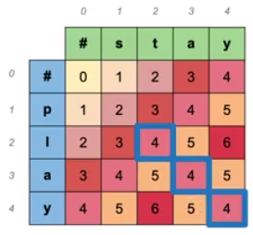
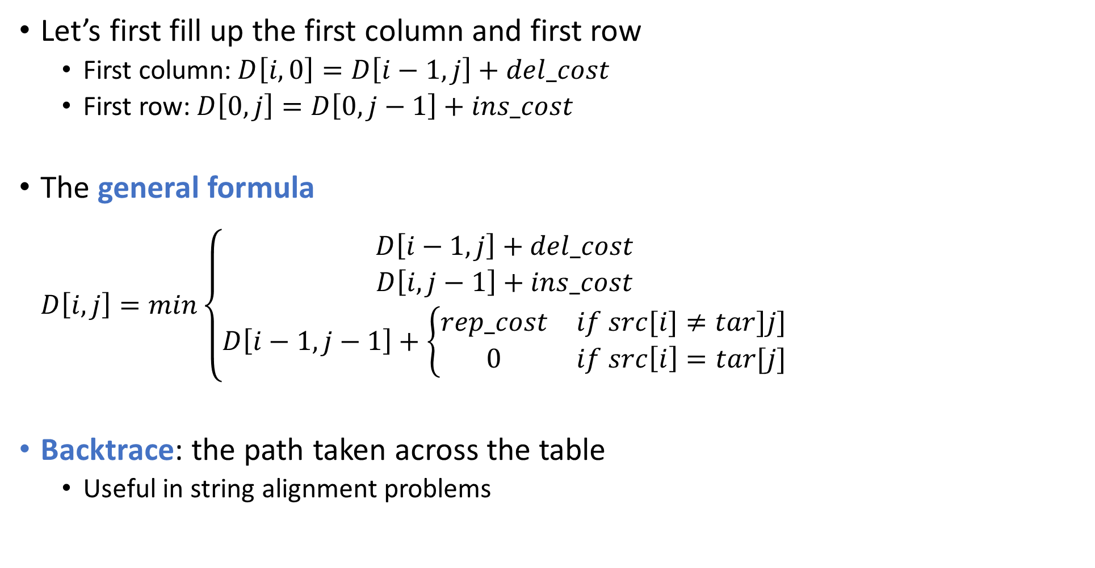
Minimum Edit Distance
0 1 2 3 4
Let’s first fill up the first column and first row
First column:$D\left[i,0\right]=D\left[i−1,j\right]+del_cost$
First row:$D\left[0,j\right]=D\left[0,j−1\right]+ins_cost$
The general formula $D\left[i,j\right]=min\left\{\begin{matrix}D\left[i−1,j\right]+del_cost \\ D\left[i,j−1\right]+ins_cost \\ D\left[i−1,j−1\right]+\left\{\begin{matrix}rep_cost & if src[i]≠tar]j] \\ 0 & if src\left[i\right]=tar[j]\end{matrix}\right.\end{matrix}\right.$
Backtrace: the path taken across the table
Useful in string alignment problems
 | # | s | t | a | y
# | 0 | 1 | 2 | 3 | 4
p | 1 | 2
l | 2
a | 3
y | 4
0
1
2
3
4

